Slide 1
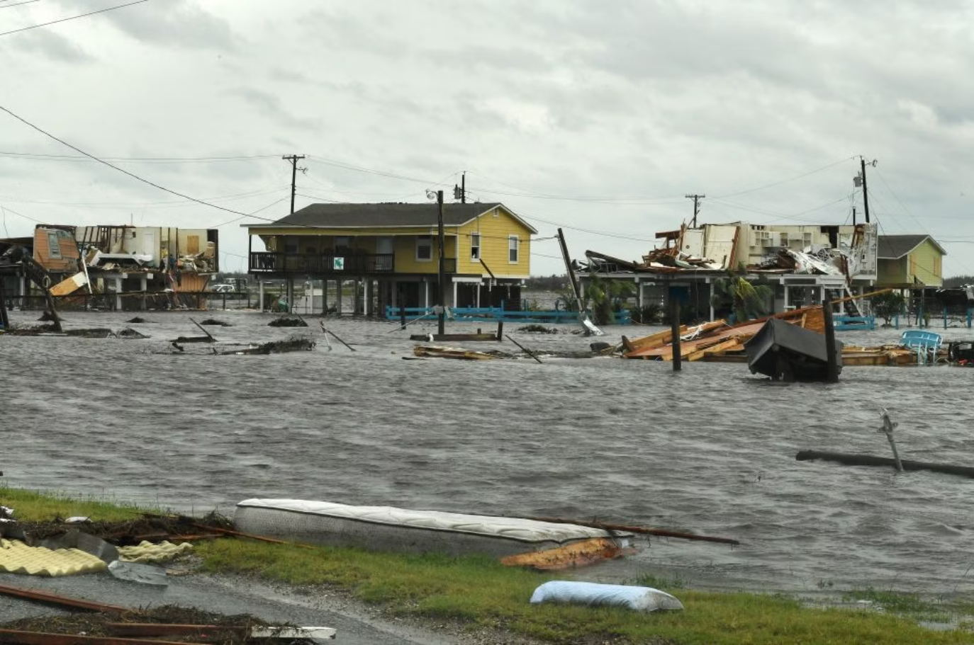

Flood Forecaster Design Story
By Team - Tech Titans

Slide 2
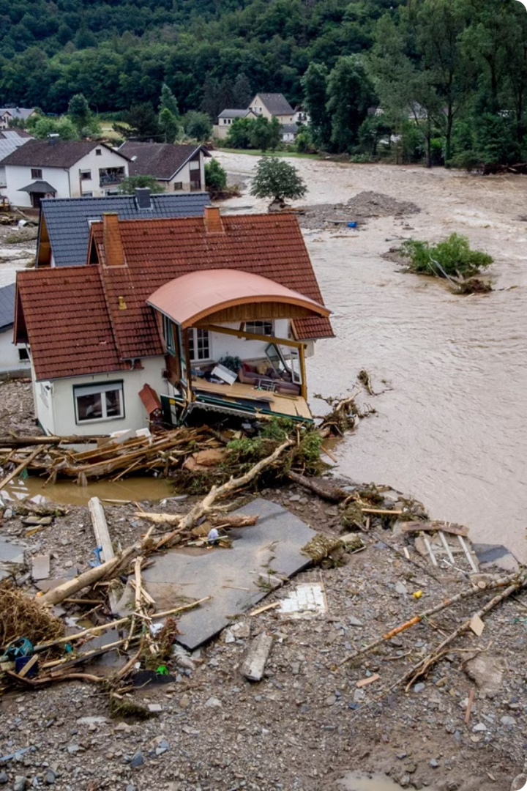
Concept and Vision
Floods are a major threat, causing widespread damage and loss. Accurate and timely flood prediction is essential for minimizing the impact. This story showcases the development of a flood prediction system utilizing machine learning algorithms to provide reliable forecasts, enabling communities to prepare for and respond to floods effectively.

Slide 3
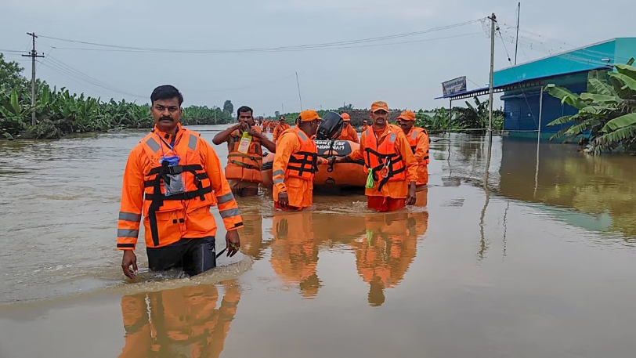
Inspiration
Flood Forecaster Pro's new flood prediction system serves as a model for other communities to adopt. By leveraging technology and collaboration, we can create safer and more resilient futures in the face of natural disasters. The goal of this project is to develop an accurate and reliable flood prediction system, providing warnings and supporting emergency preparedness and response. By identifying high-risk areas, the system can inform urban planning and decision-making, ultimately saving lives and reducing economic losses.

Slide 4
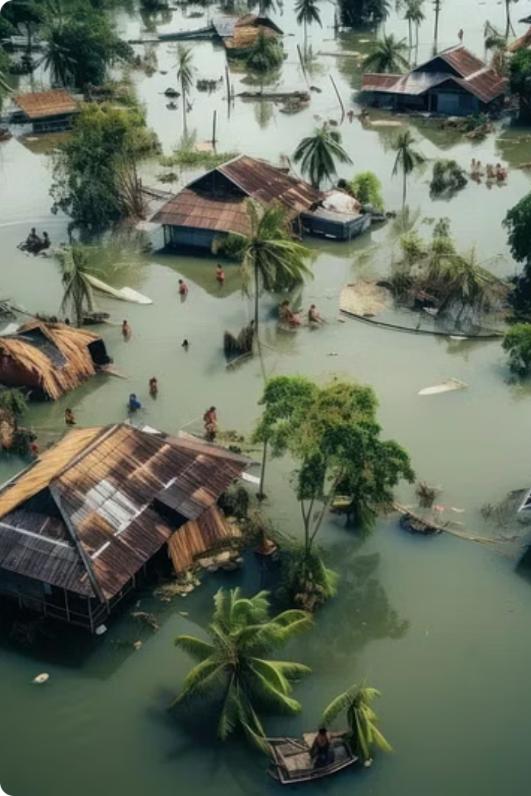
Introduction to Flood Forecasting
Maya, a spirited girl in Dakshinavati, faces yearly floods.
Destruction of homes and livelihoods drives her to seek solutions.
Inspired by the saying: "Prepare and prevent rather than repair and repent."

Slide 5

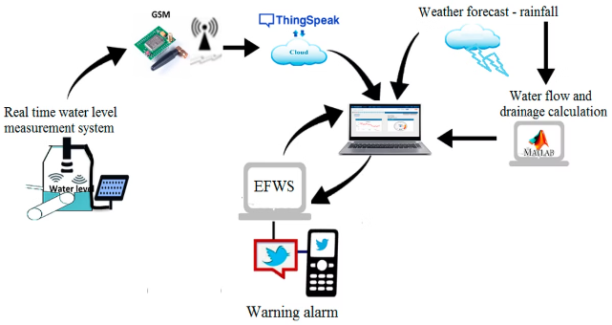
Discovery of Flood Forecaster
Maya finds "Flood Forecaster" while researching online.
Team Tech Titans uses machine learning for flood predictions.
System analyzes historical data, weather patterns, and satellite imagery.

Slide 6
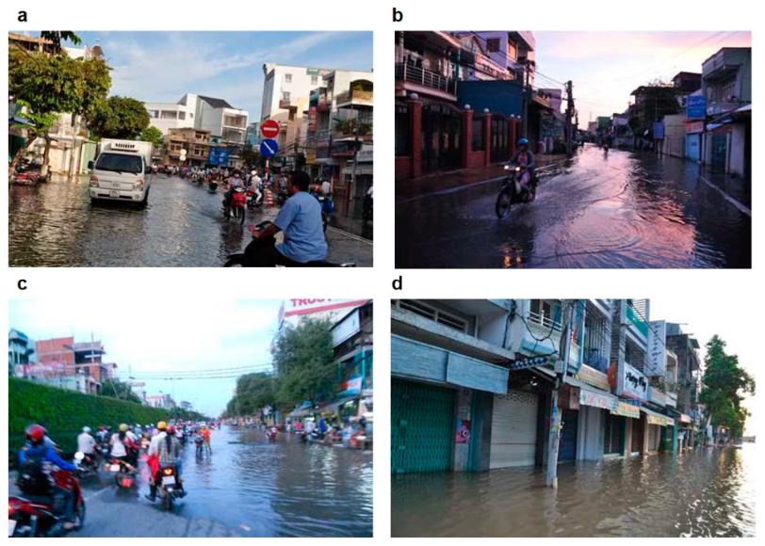
Maya's Efforts
Maya learns about data science and Flood Forecaster's algorithms.
Villagers support her vision for a flood-resilient community.
Collaboration with Tech Titans for insights

Slide 7

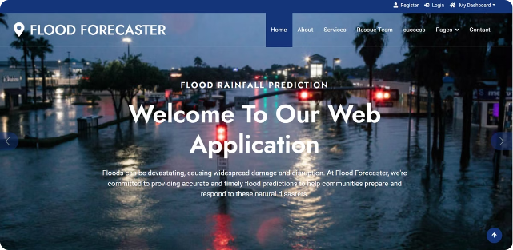
The Initiation
Maya explores the Flood Forecaster website.
User-friendly design enhances engagement.
Users input rainfall data; receive flood risk alerts or safety messages.

Slide 8


Action Against Floods
Algorithms created quickly with Maya's data.
Predictions prompt villagers to take action (erect barriers, evacuate).
Rivertown remains largely unscathed after the storm.

Slide 9

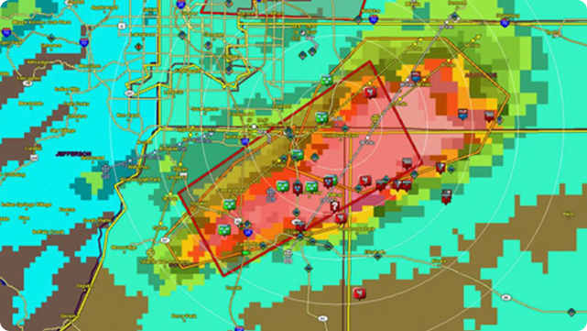
Impact and Recognition
Maya expands initiative to neighbouring villages.
Forms a network of resilience against floods.
Receives accolades, but values the positive impact on lives.
Credits Flood Forecaster for harnessing technology for good.

Slide 10

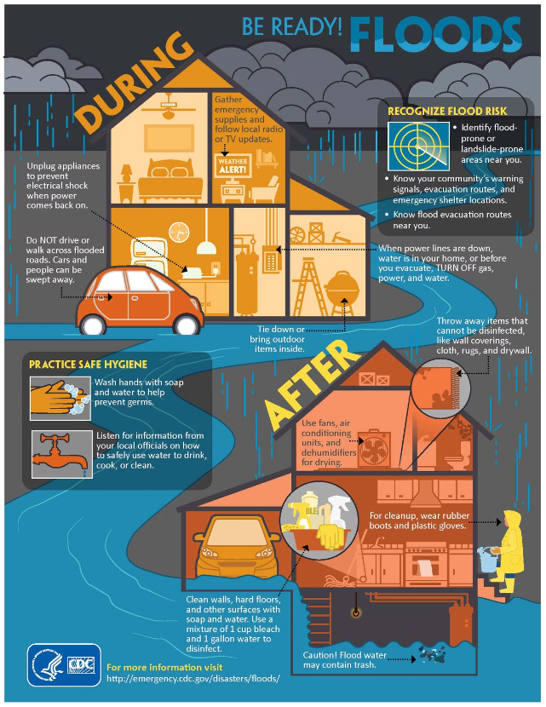
Reflection
Flood Forecaster transforms fear of floods into preparedness.
Maya's journey symbolizes community resilience and innovation.

Slide 11

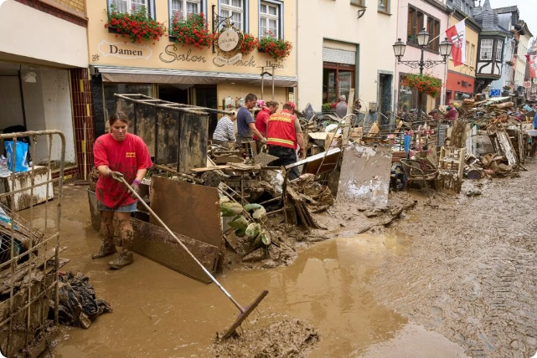
Conclusion
The Flood Forecaster Pro system showcases the effectiveness of machine learning in addressing real-world challenges. By combining historical data, real-time information, and advanced algorithms, the system has enhanced the town's flood preparedness and response capabilities, ultimately safeguarding lives and property. This pioneering approach sets a precedent for innovative disaster management solutions globally.

Slide 12


